Slide 1
Credit EDA Case Study
Prepared by:- Subham Jha

Slide 2
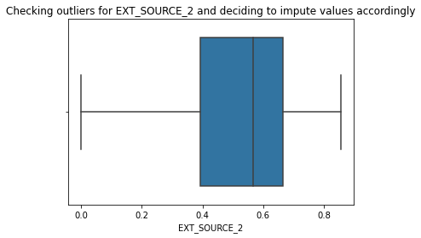
Checking Outlier on columns
We can see that there are no outliers present for the col 'EXT_SOURCE_2' and also since this is a continous variable where mean is almost equal to median we can consider to impute the null/na with the mean value which is 0.5143926741308463
Notes:
We can see that there are no outliers present for the col 'EXT_SOURCE_2' and also since this is a continous variable where mean is almost equal to median we can consider to impute the null/na with the mean value which is 0.5143926741308463

Slide 3
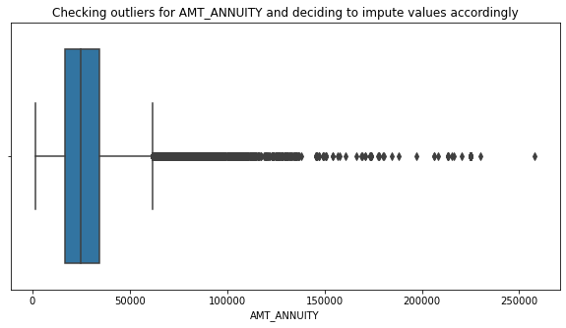
Checking Outlier on columns
For the col 'AMT_ANNUITY' which is a continous variable too,we can see there are outliers and also the graph above is right skewed which means there are extreme higher values present due to whcih the means comes out to be huge,hence for this purpose we should use median whiich is 24903.0
Notes:
For the col 'AMT_ANNUITY' which is a continous variable too,we can see there are outliers and also the graph above is right skewed which means there are extreme higher values present due to whcih the means comes out to be huge,hence for this purpose we should use median whiich is 24903.0

Slide 4
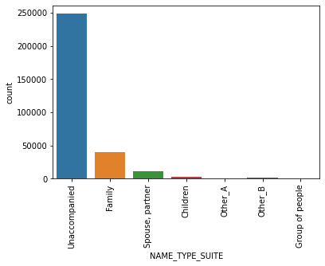
Count of name suite type
For the column 'NAME_TYPE_SUITE' which is categorical(nominal type)we can see that the value 'Unaccompanied' has the max count hence we take the mode of the col for the imputation process.
Notes:
For the column 'NAME_TYPE_SUITE' which is categorical(nominal type)we can see that the value 'Unaccompanied' has the max count hence we take the mode of the col for the imputation process.

Slide 5
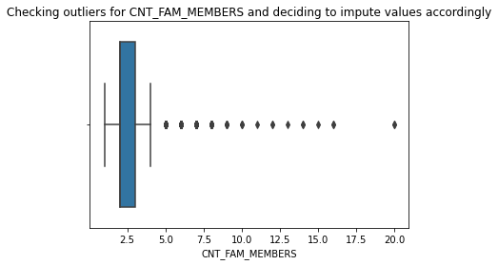
Checking Outlier on columns
As there are outliers present for the col 'CNT_FAM_MEMBERS' we should be taking median which is 2.0
Notes:
As there are outliers present for the col 'CNT_FAM_MEMBERS' we should be taking median which is 2.0

Slide 6
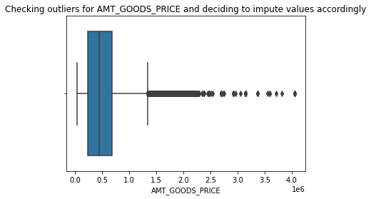
Checking Outlier on columns
For the col 'AMT_GOODS_PRICE' which is continous variable we can see there are outliers present i.e there are extreme values present so here we need to impute with median value which came out to be 450000.0.
Notes:
For the col 'AMT_GOODS_PRICE' which is continous variable we can see there are outliers present i.e there are extreme values present so here we need to impute with median value which came out to be 450000.0.

Slide 7
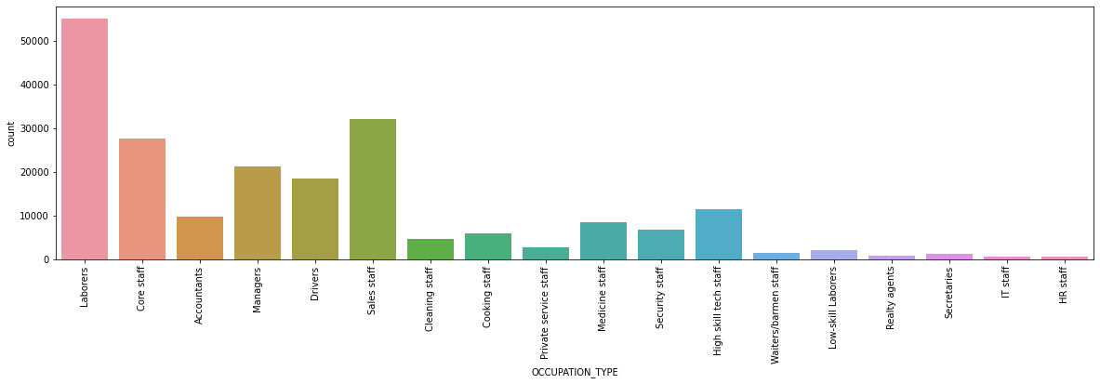
Count for occupation_type
For the col 'OCCUPATION_TYPE' which is categorical value we can use the mode value i.e 'Laborers' to impute for null values.
Notes:
For the col 'OCCUPATION_TYPE' which is categorical value we can use the mode value i.e 'Laborers' to impute for null values.

Slide 8
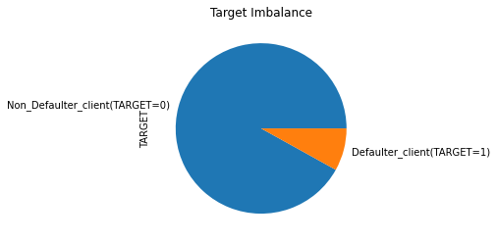
Target Imbalance
There is imbalance in the target column as target=0 is 92% and target=1 is 8%.
Notes:
There is imbalance in the target column as target=0 is 92% and target=1 is 8%.

Slide 9
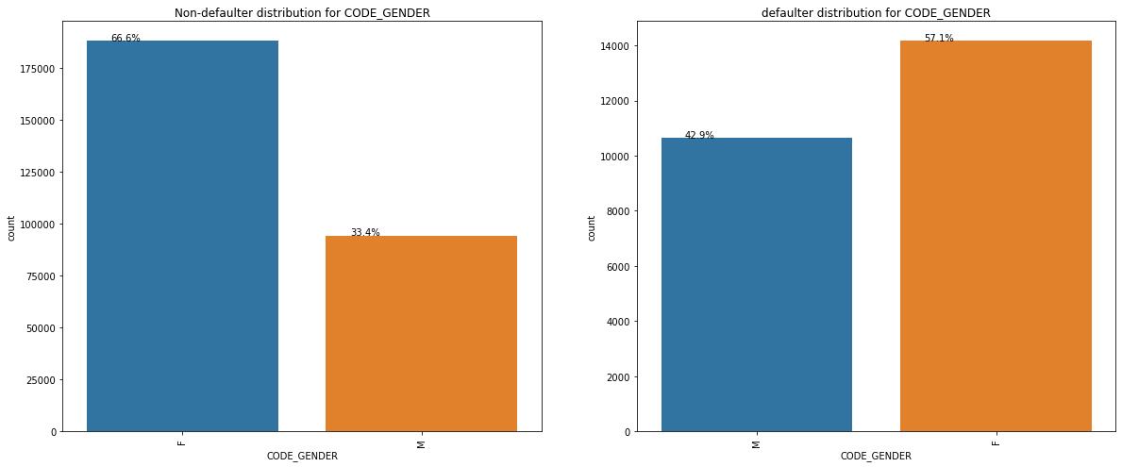
Univariate Analysis
From the above the count plot we can see that when it comes to non-defaulter or defaluter females have higher counts compared to males which infers that female are applying to loans more.Also we can see that the percent of defaulter male is higher compared to non-defaulter male
Notes:
From the above the count plot we can see that when it comes to non-defaulter or defaluter females have higher counts compared to males which infers that female are applying to loans more.Also we can see that the percent of defaulter male is higher compared to non-defaulter male

Slide 10
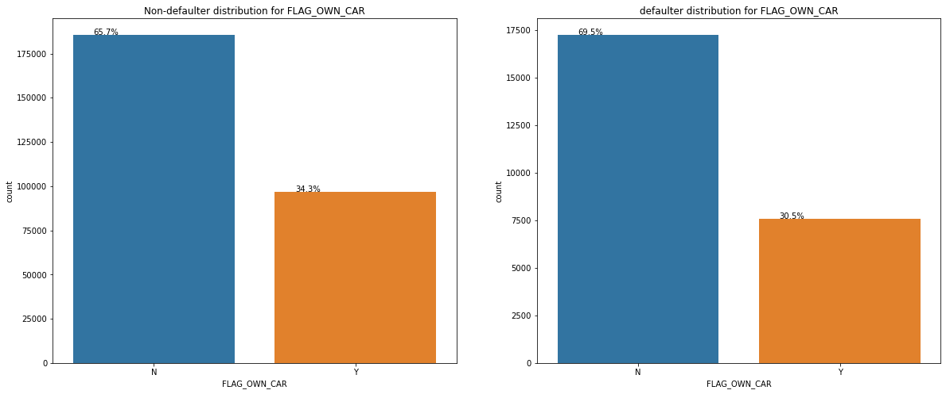
From the above plot we see that the people who are not having car are having more payment difficulties than the people who are owning car. People not owining the car are haing 65.7% of non-defaulters so it is clear that personnot owining the car are more.
Notes:
From the above plot we see that the people who are not having car are having more payment difficulties than the people who are owning car. People not owining the car are haing 65.7% of non-defaulters so it is clear that personnot owining the car are more.

Slide 11
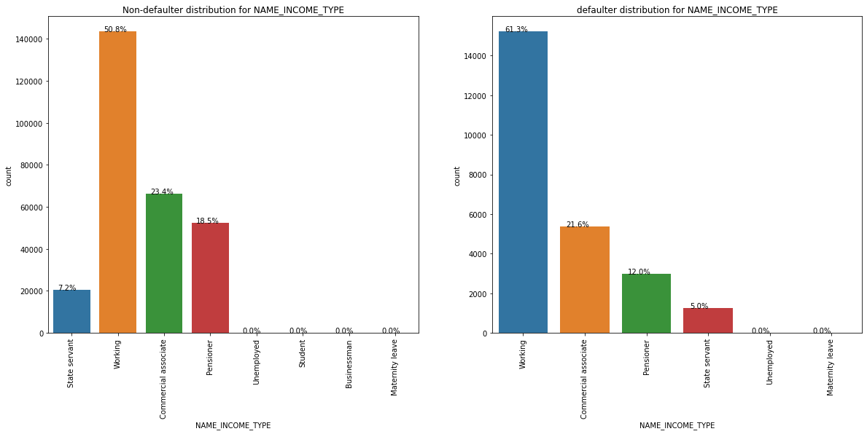
From the above plot it is observed that income type as wroking are availing the hi.ghest count of loans as they are having higher percentage in both defaulter and non defaulter list. we also see that businessmen income type is not there in defaulter list i.e businessmen never defaults
Notes:
From the above plot it is observed that income type as wroking are availing the hi.ghest count of loans as they are having higher percentage in both defaulter and non defaulter list. we also see that businessmen income type is not there in defaulter list i.e businessmen never defaults

Slide 12
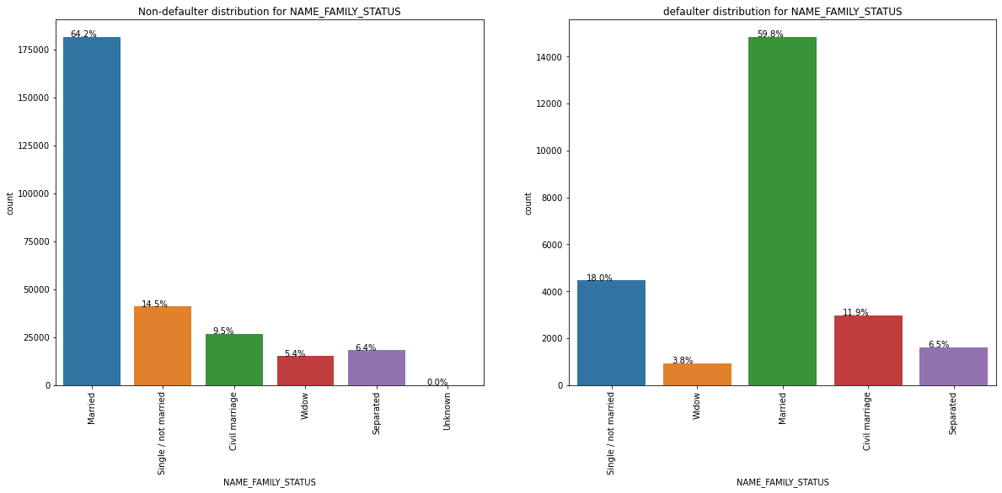
Married people are taking much loan when compared to other family status as they are having higher no of percentage in both defaulter and non defaulter dataframe. Seperated have same percent of defaulter and non defaulter
Notes:
Married people are taking much loan when compared to other family status as they are having higher no of percentage in both defaulter and non defaulter dataframe. Seperated have same percent of defaulter and non defaulter

Slide 13
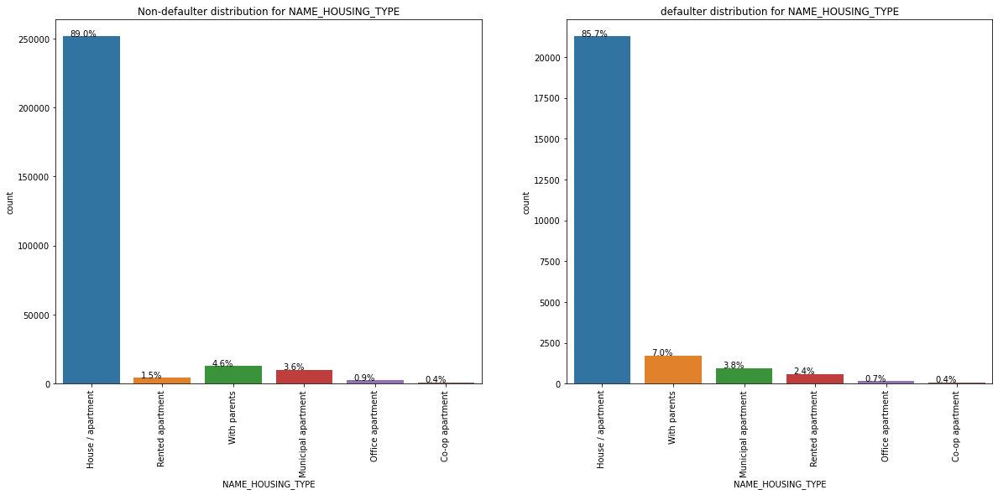
From the above plot we can see that people having housing type as hous/appartment are applying for more loans. people living with parents are having difficulties in payment
Notes:
From the above plot we can see that people having housing type as hous/appartment are applying for more loans. people living with parents are having difficulties in payment

Slide 14
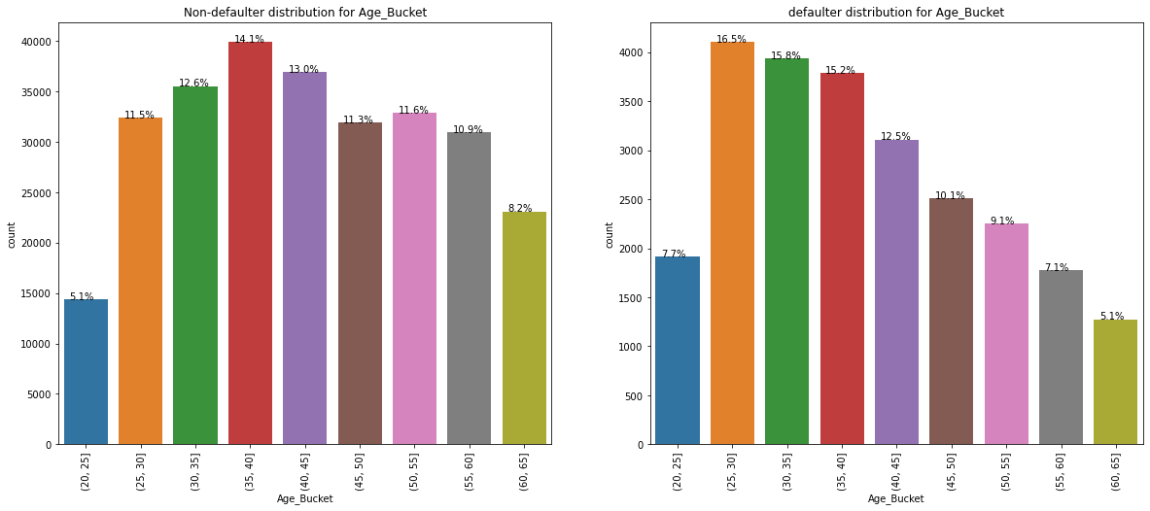
We could observe that age-group between 25-30 are having difficulties in payments whne compared to other age group. We can see that the age-group graph for defaulter is been decreasing starting the age group 25-30.
Notes:
We could observe that age-group between 25-30 are having difficulties in payments whne compared to other age group. We can see that the age-group graph for defaulter is been decreasing starting the age group 25-30.

Slide 15
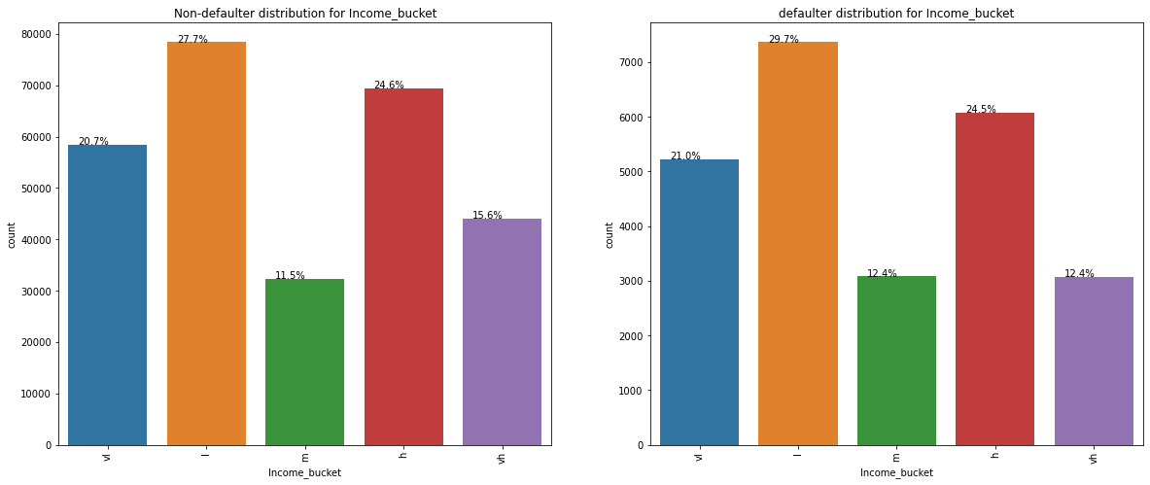
From the above graph we can see that people with low income comprises the most, as their percentage is higher in both defaulter and non-defaulter . very high income people tend to default the least along with medium income range people
Notes:
From the above graph we can see that people with low income comprises the most, as their percentage is higher in both defaulter and non-defaulter . very high income people tend to default the least along with medium income range people

Slide 16
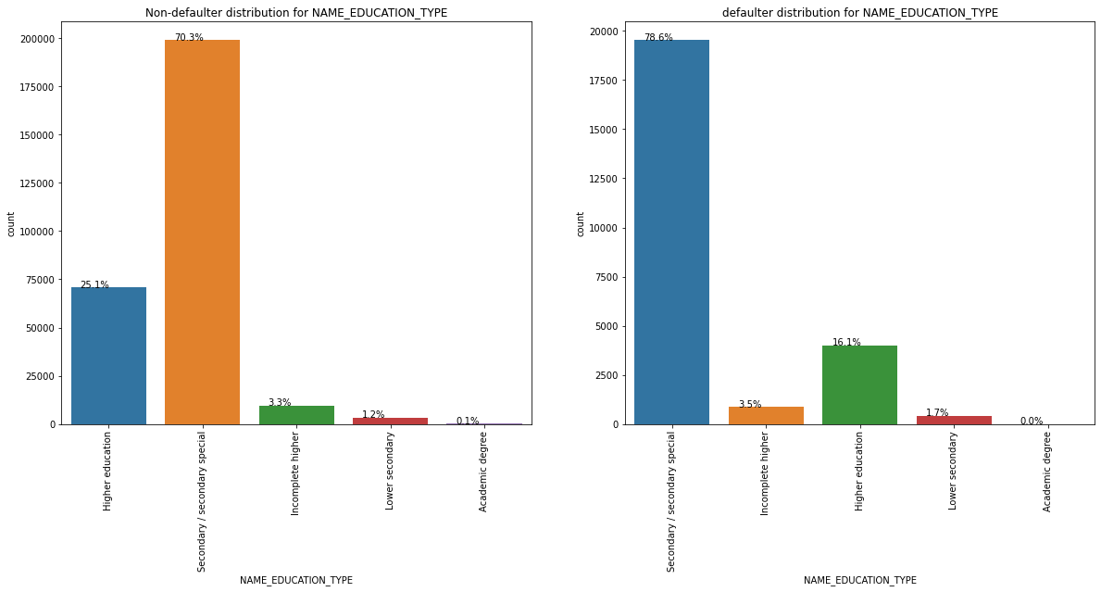
Notes:
people with secondary education tends to default the most. The defaulting rate of higher education ones are less when compared to others.

Slide 17
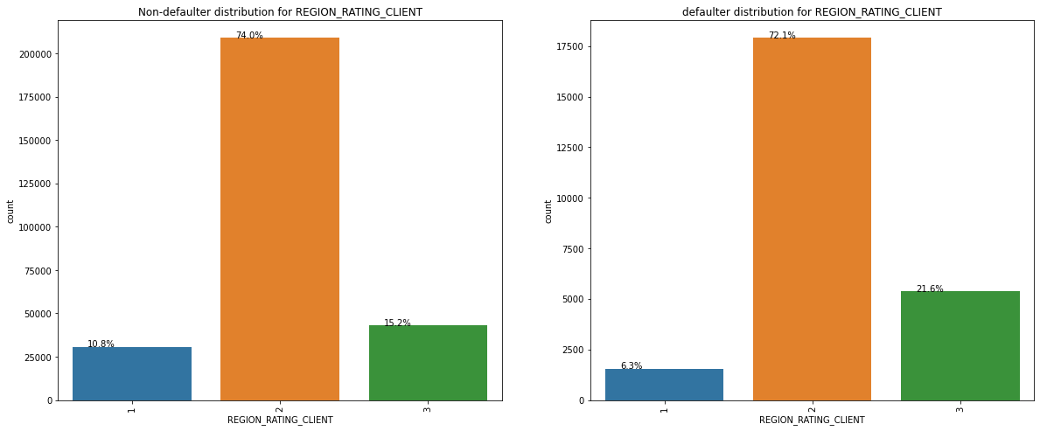
People living in region rated as 2 are applying for loans more. people living in 3 rated regions tends to default more.
Notes:
People living in region rated as 2 are applying for loans more. people living in 3 rated regions tends to default more.

Slide 18
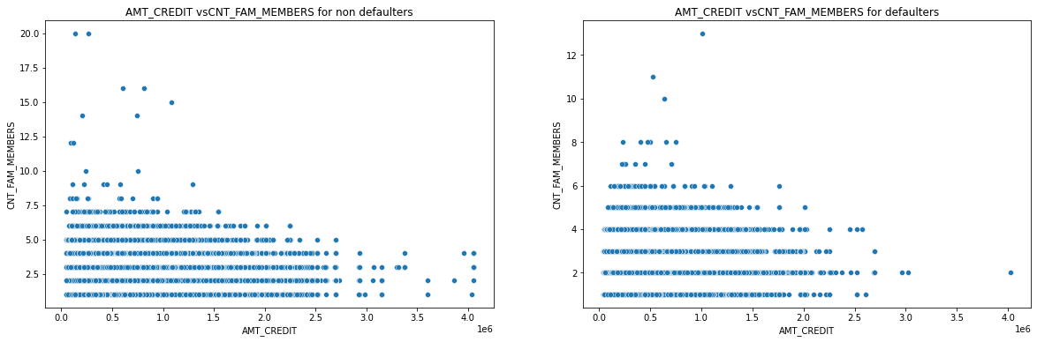
Bivariate analysis
We can see that client with less family members and low amount credit are more likely to default.Also there are vey few defaulter with hight count of family members and high amount credit
Notes:
We can see that client with less family members and low amount credit are more likely to default.Also there are vey few defaulter with hight count of family members and high amount credit

Slide 19
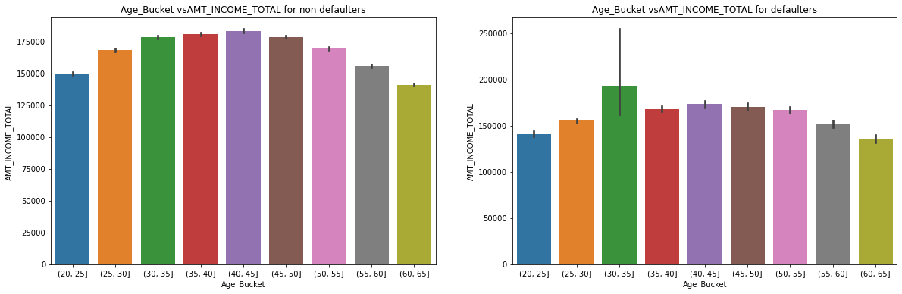
From the above graph it is observed that with increase in age the probability of defaulting becomes less and also the income decreases too.
Notes:
From the above graph it is observed that with increase in age the probability of defaulting becomes less and also the income decreases too.

Slide 20
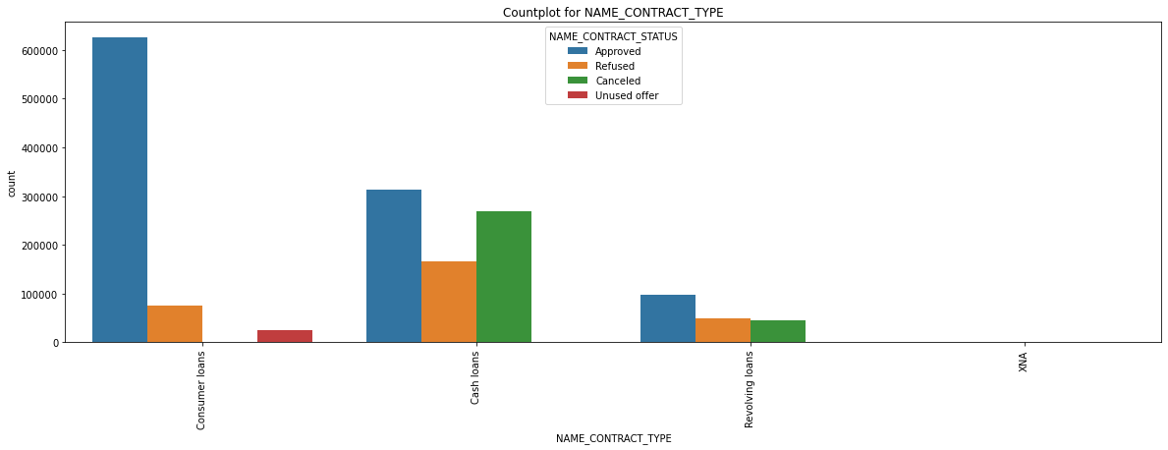
Univariate analysis of prev app dataset
From the above plot it can be observed the contract type with Cash loans and Consumer loans are approved the most. also cash loans are either cancelled or refused the most when compared with other types..
Notes:
From the above plot it can be observed the contract type with Cash loans and Consumer loans are approved the most. also cash loans are either cancelled or refused the most when compared with other types..

Slide 21
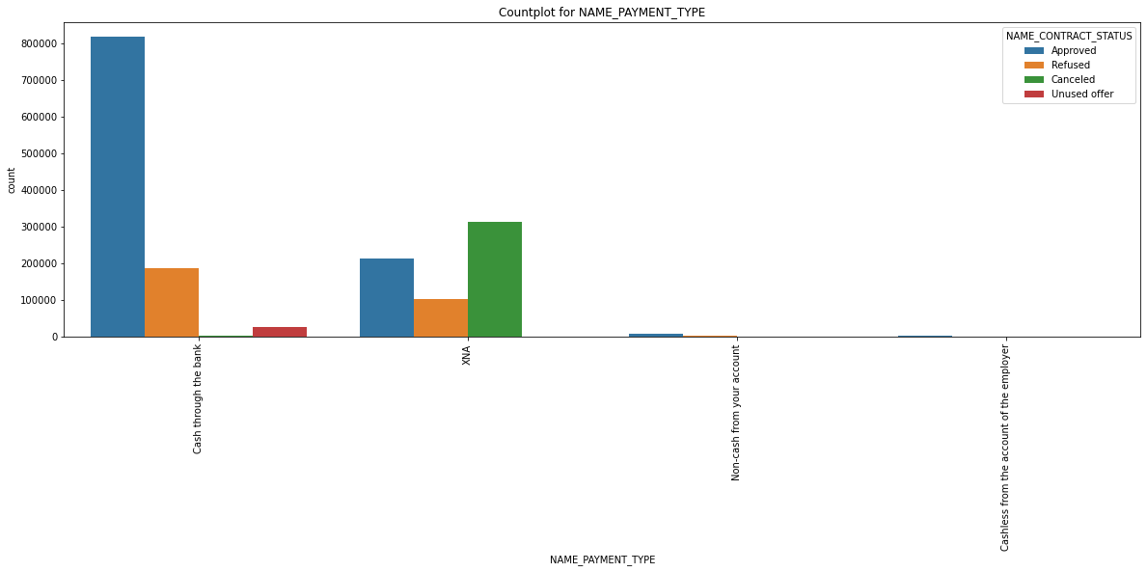
Cash through the bank is the most approved payment type mode. Cashless from the account of the employer is the least approved type of payment mode.
Notes:
Cash through the bank is the most approved payment type mode. Cashless from the account of the employer is the least approved type of payment mode.

Slide 22
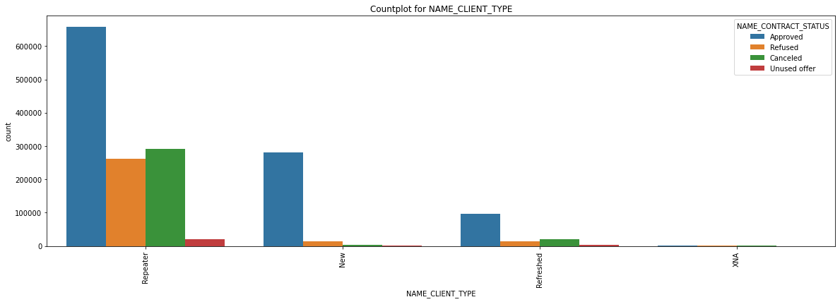
From the above plot we can observe that new application and repeater application are the most approved ones. Also repeaters are the ones which are refused most
Notes:
From the above plot we can observe that new application and repeater application are the most approved ones. Also repeaters are the ones which are refused most

Slide 23
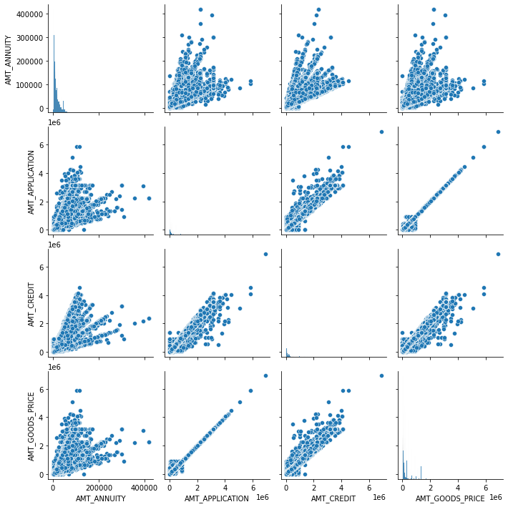
Bivariate analysis using pairplot
Notes:
From the above plot we see that annuty of previous application increases with below facotrs: a)how much credit did client ask on the previous application b)Final credit amount on the previous application c)Goods price of good that client asked for (if applicable) on the previous application
How much credit did client ask on the previous application increases with the increase in good that client asked for (if applicable) on the previous application.
Final credit amount on the previous application that was approved by the bank is positively increasing with how much credit did client ask on the previous application and Goods price of good that client asked for (if applicable) on the previous application

Slide 24
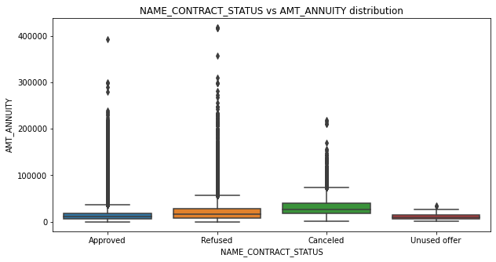
Bivariate analysis using boxplot
We could see that amt with highest annuity gets refused. with lower annuity get's cancelled or unused.
Notes:
We could see that amt with highest annuity gets refused. with lower annuity get's cancelled or unused.

Slide 25
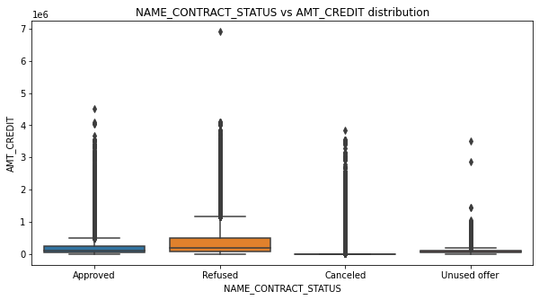
From the above plot we see that when the credited amt is too low it gets cancelled or unused.
Notes:
From the above plot we see that when the credited amt is too low it gets cancelled or unused.

Slide 26
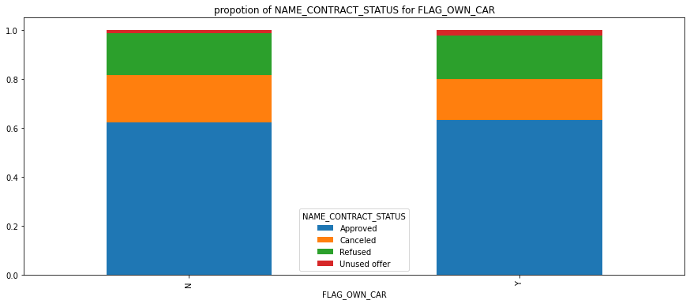
Analysis using stacked bar chart
From the above plot we cannot see any difference between the people ownning and not owning the car impacting the contract status.The proportion of apprved,cancelled,refused and unused offer is same almost.
Notes:
From the above plot we cannot see any difference between the people ownning and not owning the car impacting the contract status.The proportion of apprved,cancelled,refused and unused offer is same almost.

Slide 27
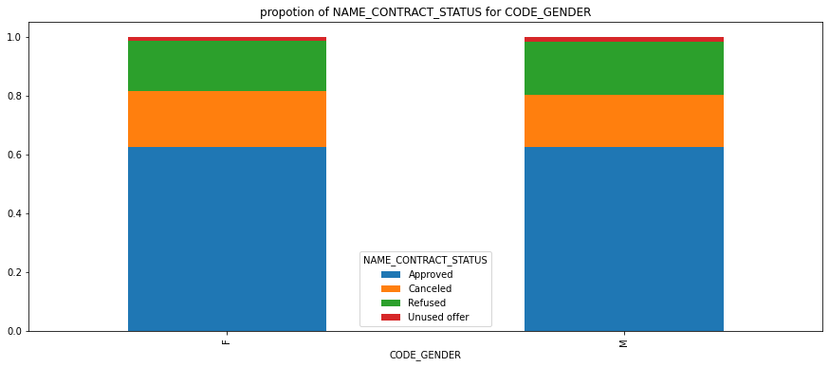
From the above plot we see that approved and refused contract status is same for both the gender
Notes:
From the above plot we see that approved and refused contract status is same for both the gender

Slide 28
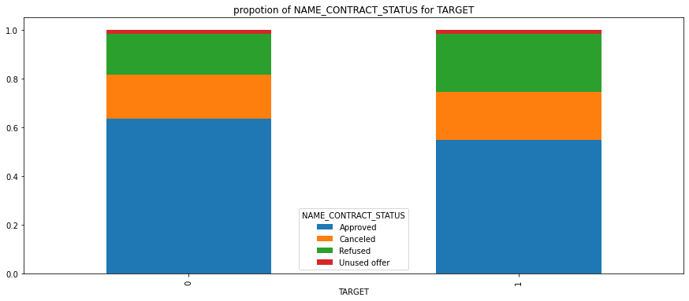
People with payment difficulties is seen to have less proportion of approved loans when compared with people having no difficulties and also these people have higher chances of their loan being refused
Notes:
People with payment difficulties is seen to have less proportion of approved loans when compared with people having no difficulties and also these people have higher chances of their loan being refused

